Slide 1
Why Computer Security
The past decade has seen an explosion in the concern for the security of information
  Malicious codes (viruses, worms, etc.) caused over $28 billion in economic losses in 2003, and will grow to over $75 billion by 2007
Jobs and salaries for technology professionals have lessened in recent years. BUT …
Security specialists markets are expanding !
  “ Full-time information security professionals will rise almost 14% per year around the world, going past 2.1 million in 2008” (IDC report)
Notes:
2.4 billion loss: http://www.gao.gov/docdblite/summary.php?recflag=&accno=A01693&rptno=GAO-01-1073T
Economic loss: http://www.mxlogic.com/PDFs/IndustryStats.2.28.04.pdf

Slide 2
Why Computer Security (cont’d)
Internet attacks are increasing in frequency, severity and sophistication
Denial of service (DoS) attacks
  Cost $1.2 billion in 2000
  1999 CSI/FBI survey 32% of respondents detected DoS attacks directed to their systems
  Thousands of attacks per week in 2001
  Yahoo, Amazon, eBay, Microsoft, White House, etc., attacked
Notes:
2.4 billion loss: http://www.gao.gov/docdblite/summary.php?recflag=&accno=A01693&rptno=GAO-01-1073T
Economic loss: http://www.mxlogic.com/PDFs/IndustryStats.2.28.04.pdf

Slide 3
Why Computer Security (cont’d)
Virus and worms faster and powerful
  Melissa, Nimda, Code Red, Code Red II, Slammer …
  Cause over $28 billion in economic losses in 2003, growing to over $75 billion in economic losses by 2007.
  Code Red (2001): 13 hours infected >360K machines - $2.4 billion loss
  Slammer (2003): 10 minutes infected > 75K machines - $1 billion loss
Spams, phishing …
New Internet security landscape emerging: BOTNETS !
Notes:
2.4 billion loss: http://www.gao.gov/docdblite/summary.php?recflag=&accno=A01693&rptno=GAO-01-1073T
Economic loss: http://www.mxlogic.com/PDFs/IndustryStats.2.28.04.pdf

Slide 4
Overview
Course Administrative Trivia
What is security: history and definition
Security policy, mechanisms and services
Security models

Slide 5
Course Objective
Understand the basic principles for information and communication security, and be able to apply these principles to evaluate and criticize information system security properties
Be able to use some important and popular security tools, like encryption, digital signatures, firewalls, intrusion detection systems (IDS)
Be able to identify the vulnerability of the Internet systems and recognize the mechanisms of the attacks, and apply them to design and evaluate counter-measure tools

Slide 6
Course Contents
Cryptography
  Secret key algorithms: DES/AES
  Public key algorithms: RSA
  One-way hash functions & message digests: MD5, SHA2
Authentication, access control, public key infrastructure (PKI, briefly)
  Case study: Kerberos
Internet vulnerability
  Denial-of-service attacks
  Viruses, worms, Trojan horses
Notes:
We will also briefly discuss network security.

Slide 7
Course Contents (cont’d)
Securing the Internet
  Intrusion detection systems (IDSs): host- vs. network- based, signature vs. statistical detection
  Case study: Snort and Bro
  Firewalls, VPN and IPsec
Software security
  Buffer overflow, heap overflow and string format bugs
  Detection techniques: static program analysis vs. run-time detection
Operating system security
  Dealing with bad (legacy) codes: sandboxing
  Multi-level security, file system security

Slide 8
Overview
Course Administrative Trivia
What is security: history and definition
Security policy, mechanisms and services
Security models

Slide 9
The History of Computing
For a long time, security was largely ignored in the community
  The computer industry was in “survival mode”, struggling to overcome technological and economic hurdles
  As a result, a lot of comers were cut and many compromises made
  There was lots of theory, and even examples of systems built with very good security, but were largely ignored or unsuccessful
    E.g., ADA language vs. C (powerful and easy to use)
Notes:
http://www.adaic.com/whyada/ada-vs-c/cada_art.html
Classical ADA vs C comparison.
ADA was invented after C, but couldn’t get wide adoption.

Slide 10
Computing Today is Very Different
Computers today are far from “survival mode”
  Performance is abundant and the cost is very cheap
  As a result, computers now ubiquitous at every facet of society
Internet
  Computers are all connected and interdependent
  This codependency magnifies the effects of any failures

Slide 11
Biological Analogy
Computing today is very homogeneous.
  A single architecture and a handful of OS dominates
In biology, homogeneous populations are in danger
  A single disease or virus can wipe them out overnight because they all share the same weakness
  The disease only needs a vector to travel among hosts
Computers are like the animals, the Internet provides the vector.
  It is like having only one kind of cow in the world, and having them drink from one single pool of water!

Slide 12
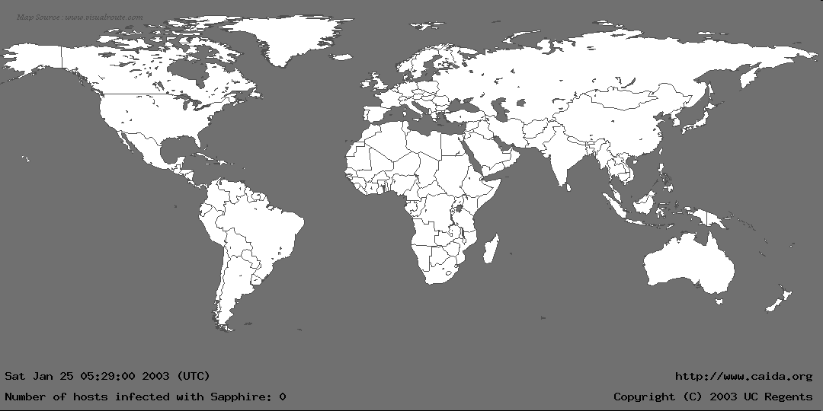
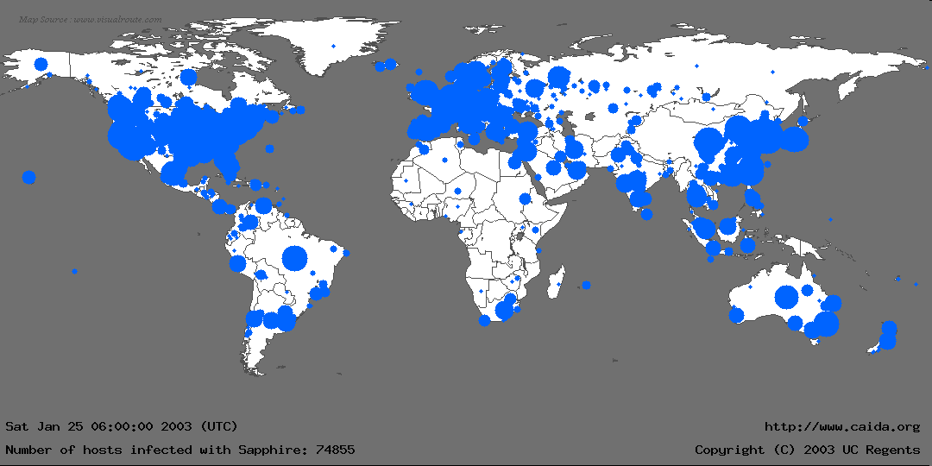
The Spread of Sapphire/Slammer Worms
Notes:
In the first 30 minutes of Sapphire’s spread, we recorded nearly 75,000 unique infections. As we will detail later, most of these infections actually occurred within 10 minutes.
This graphic is more for effect rather than technical detail: We couldn’t determine a detailed location for all infections, and the diameter of each circle is proportional to the lg() of the number of infections, underrepresenting larger infections. Nevertheless, it gives a good feel for where Sapphire spread.
We monitored the spread using several “Network Telescopes”, address ranges where we had sampled or complete packet traces at single sources. We also used the D-shield distributed intrusion detection system to determine IPs of infected machines, but we couldn’t use this data for calculating the scanning rate.

Slide 13
The Flash Worm
Slammer worm infected 75,000 machines in <15 minutes
A properly designed worm, flash worm, can take less than 1 second to compromise 1 million vulnerable machines in the Internet
  The Top Speed of Flash Worms. S. Staniford, D. Moore, V. Paxson and N. Weaver, ACM WORM Workshop 2004.
  Exploit many vectors such as P2P file sharing, intelligent scanning, hitlists, etc.

Slide 14
The Definition of Computer Security
Security is a state of well-being of information and infrastructures in which the possibility of successful yet undetected theft, tampering, and disruption of information and services is kept low or tolerable
Security rests on confidentiality, authenticity, integrity, and availability

Slide 15
The Basic Components
Confidentiality is the concealment of information or resources.
  E.g., only sender, intended receiver should “understand” message contents
Authenticity is the identification and assurance of the origin of information.
Integrity refers to the trustworthiness of data or resources in terms of preventing improper and unauthorized changes.
Availability refers to the ability to use the information or resource desired.

Slide 16
Security Threats and Attacks
A threat/vulnerability is a potential violation of security.
  Flaws in design, implementation, and operation.
An attack is any action that violates security.
  Active adversary
An attack has an implicit concept of “intent”
  Router mis-configuration or server crash can also cause loss of availability, but they are not attacks

Slide 17



Friends and enemies: Alice, Bob, Trudy
well-known in network security world
Bob, Alice (lovers!) want to communicate “securely”
Trudy (intruder) may intercept, delete, add messages
Alice
Bob
channel
data, control messages
secure
sender
secure
receiver
data
data
Trudy

Slide 18
Eavesdropping - Message Interception (Attack on Confidentiality)
Unauthorized access to information
Packet sniffers and wiretappers
Illicit copying of files and programs
A
B
Eavesdropper

Slide 19
Integrity Attack - Tampering With Messages
Stop the flow of the message
Delay and optionally modify the message
Release the message again
A
B
Perpetrator

Slide 20
Authenticity Attack - Fabrication
Unauthorized assumption of other’s identity
Generate and distribute objects under this identity
A
B
Masquerader: from A

Slide 21
Attack on Availability
Destroy hardware (cutting fiber) or software
Modify software in a subtle way (alias commands)
Corrupt packets in transit
Blatant denial of service (DoS):
  Crashing the server
  Overwhelm the server (use up its resource)
A
B

Slide 22
Classify Security Attacks as
Passive attacks - eavesdropping on, or monitoring of, transmissions to:
  obtain message contents, or
  monitor traffic flows
Active attacks – modification of data stream to:
  masquerade of one entity as some other
  replay previous messages
  modify messages in transit
  denial of service
Notes:
Passive attacks: confidentiality
Active attacks can violate other 3 properties

Slide 23
Overview
Course Administrative Trivia
What is security: history and definition
Security policy, mechanisms and services
Security models

Slide 24
Security Policy and Mechanism
Policy: a statement of what is, and is not allowed.
Mechanism: a procedure, tool, or method of enforcing a policy.
Security mechanisms implement functions that help prevent, detect, and respond to recovery from security attacks.
Security functions are typically made available to users as a set of security services through APIs or integrated interfaces.
Cryptography underlies many security mechanisms.
Notes:
Give examples. Eg, confidentiality is a security service. Cryptography is mechanism. The data is confident to whom is expressed by policies.

Slide 25
OSI Security Architecture
ITU-T X.800 Security Architecture for OSI
Defines a systematic way of defining and providing security requirements
For us it provides a useful, if abstract, overview of concepts we will study
X.800 defines security services in 5 major categories

Slide 26
Security Services (X.800)
Authentication - assurance that the communicating entity is the one claimed
Access Control - prevention of the unauthorized use of a resource
Data Confidentiality –protection of data from unauthorized disclosure
Data Integrity - assurance that data received is as sent by an authorized entity
Non-Repudiation - protection against denial by one of the parties in a communication
Notes:
See Table 1.4 for details of the 5 Security Service categories and the 14 specific services.

Slide 27
Security Mechanisms (X.800)
Specific security mechanisms:
  Encipherment
  Digital signatures
  Access controls
  Data integrity
  Authentication exchange
  Traffic padding
  Routing control
  Notarization
Pervasive security mechanisms:
  Trusted functionality
  Security labels
  Event detection
  Security audit trails
  Security recovery
Notes:
see Table 1.5 for details of these mechanisms, and Table 1.6 for the relationship between services and mechanisms.
The “specific security mechanisms” are protocol layer specific, whilst the “pervasive security mechanisms” are not.
Will meet some of these mechanisms in much greater detail later.

Slide 28
Overview
Course Administrative Trivia
What is security: history and definition
Security policy, mechanisms and services
Security models

Slide 29

Model for Network Security
Notes:
In considering the place of encryption, its useful to use the following two models. The first models information flowing over an insecure communications channel, in the presence of possible opponents. Hence an appropriate security transform (encryption algorithm) can be used, with suitable keys, possibly negotiated using the presence of a trusted third party.

Slide 30
Model for Network Security
Using this model requires us to:
  Design a suitable algorithm for the security transformation
  Generate the secret information (keys) used by the algorithm
  Develop methods to distribute and share the secret information
  Specify a protocol enabling the principals to use the transformation and secret information for a security service

Slide 31

Model for Network Access Security
Notes:
The second model is concerned with controlled access to information or resources on a computer system, in the presence of possible opponents. Here appropriate controls are needed on the access and within the system, to provide suitable security. Some cryptographic techniques are useful here also.

Slide 32
Model for Network Access Security
Using this model requires us to:
  Select appropriate gatekeeper functions to identify users
  Implement security controls to ensure only authorised users access designated information or resources
Trusted computer systems can be used to implement this model

Slide 33
Backup Slides

Slide 34
How to Make a System Trustworthy
Specification
  A statement of desired functions
Design
  A translation of specifications to a set of components
Implementation
  Realization of a system that satisfies the design
Assurance
  The process to insure that the above steps are carried out correctly
  Inspections, proofs, testing, etc.

Slide 35
The Security Life Cycle
The iterations of
  Threats
  Policy
  Specification
  Design
  Implementation
  Operation and maintenance

